Slide 1
Kelompok 10
Saeful Anwar
01
15.11.0210
Nida Arwanti Fauzaa
02
18.11.0016
Luthfy Ery Sandi
03
18.11.0035
Mohamad Nur Fahmi
04
18.11.0048

Slide 2
Counter Up/Down

Slide 3
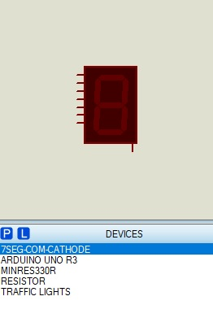
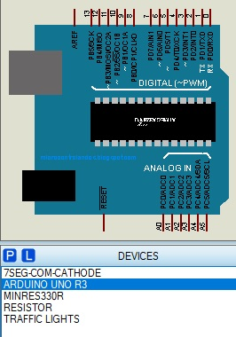
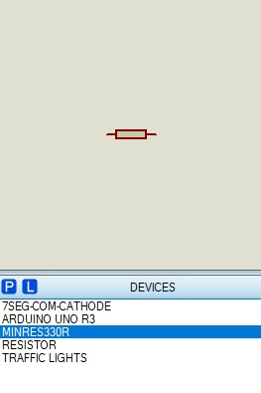
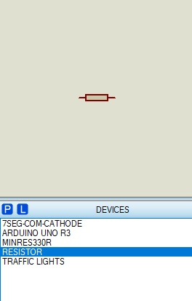
PICK DEVICES
7 SEGMENTS
ARDUINO
MINRES 330R
RESISTOR

Slide 4
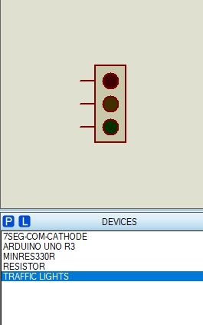
PICK DEVICES
TRAFFIC LIGHT

Slide 5
CODE
int LED1 = 13;
int LED2 = 11;
int LED3 = 9;
int DELAY_LED = 2750; //1detik = 1000ms
void setup() {
// put your setup code here, to run once:
pinMode(2,OUTPUT);
pinMode(3,OUTPUT);
pinMode(4,OUTPUT);
pinMode(5,OUTPUT);
pinMode(6,OUTPUT);
pinMode(7,OUTPUT);
pinMode(8,OUTPUT);
pinMode (LED1, OUTPUT);
pinMode (LED2, OUTPUT);
pinMode (LED3, OUTPUT);
}
void loop() {
// put your main code here, to run repeatedly:
digitalWrite (LED1, HIGH);
one();
two();
three();
four();
five();
six();
seven();
eight();
nine();
ten();

Slide 6
CODE
one();
two();
three();
four();
five();
six();
seven();
eight();
nine();
ten();
digitalWrite (LED3, LOW);
digitalWrite (LED2, HIGH);
delay(1000);
digitalWrite (LED2, LOW);
}
void zero() {
digitalWrite(2,HIGH);
digitalWrite(3,HIGH);
digitalWrite(4,HIGH);
digitalWrite(5,HIGH);
digitalWrite(6,HIGH);
digitalWrite(7,HIGH);
digitalWrite(8,LOW);
delay(250);
}
void one(){
digitalWrite(2,HIGH);
digitalWrite(3,HIGH);
digitalWrite(4,HIGH);
digitalWrite(5,HIGH);
digitalWrite(6,LOW);
digitalWrite(7,HIGH);
digitalWrite(8,HIGH);
delay(250);
}

Slide 7
CODE
void two() {
digitalWrite(2,HIGH);
digitalWrite(3,HIGH);
digitalWrite(4,HIGH);
digitalWrite(5,HIGH);
digitalWrite(6,HIGH);
digitalWrite(7,HIGH);
digitalWrite(8,HIGH);
delay(250);
}
void three() {
digitalWrite(2,HIGH);
digitalWrite(3,HIGH);
digitalWrite(4,HIGH);
digitalWrite(5,LOW);
digitalWrite(6,LOW);
digitalWrite(7,LOW);
digitalWrite(8,LOW);
delay(250);
}
void four() {
digitalWrite(2,HIGH);
digitalWrite(3,LOW);
digitalWrite(4,HIGH);
digitalWrite(5,HIGH);
digitalWrite(6,HIGH);
digitalWrite(7,HIGH);
digitalWrite(8,HIGH);
delay(250);
}
void five() {
digitalWrite(2,HIGH);
digitalWrite(3,LOW);
digitalWrite(4,HIGH);
digitalWrite(5,HIGH);
digitalWrite(6,LOW);
digitalWrite(7,HIGH);
digitalWrite(8,HIGH);
delay(250);
}

Slide 8
CODE
void six() {
digitalWrite(2,LOW);
digitalWrite(3,HIGH);
digitalWrite(4,HIGH);
digitalWrite(5,LOW);
digitalWrite(6,LOW);
digitalWrite(7,HIGH);
digitalWrite(8,HIGH);
delay(250);
}
void seven() {
digitalWrite(2,HIGH);
digitalWrite(3,HIGH);
digitalWrite(4,HIGH);
digitalWrite(5,HIGH);
digitalWrite(6,LOW);
digitalWrite(7,LOW);
digitalWrite(8,HIGH);
delay(250);
}
void eight() {
digitalWrite(2,HIGH);
digitalWrite(3,HIGH);
digitalWrite(4,LOW);
digitalWrite(5,HIGH);
digitalWrite(6,HIGH);
digitalWrite(7,LOW);
digitalWrite(8,HIGH);
delay(250);
}
void nine() {
digitalWrite(2,LOW);
digitalWrite(3,HIGH);
digitalWrite(4,HIGH);
digitalWrite(5,LOW);
digitalWrite(6,LOW);
digitalWrite(7,LOW);
digitalWrite(8,LOW);
delay(250);
}

Slide 9
CODE
void ten() {
digitalWrite(2,HIGH);
digitalWrite(3,HIGH);
digitalWrite(4,HIGH);
digitalWrite(5,HIGH);
digitalWrite(6,HIGH);
digitalWrite(7,HIGH);
digitalWrite(8,LOW);
delay(250);
}

Slide 10
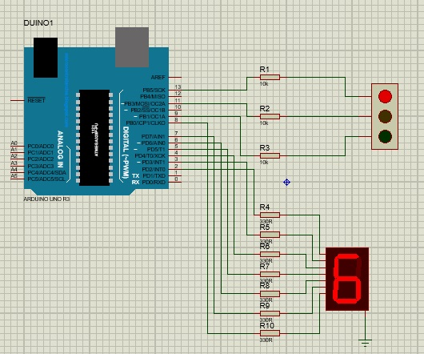
COUNTER DOWN SERIES

